Slide 1
QUEUE
Kharisma Monika Dian Pertiwi S.Kom., M.Kom
INFORMATIKA
INSTITUT TEKNOLOGI TELKOM SURABAYA

Slide 2

QUEUE
Antrian

Slide 3
QUEUE - IN
5
4
3
2
1

Slide 4
QUEUE - OUT
5
4
3
2
1

Slide 5
QUEUE
abstract data structure
Mengikuti urutan FIFO atau LILO

Slide 6

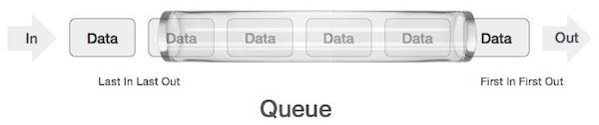
Queue Representation

Slide 7
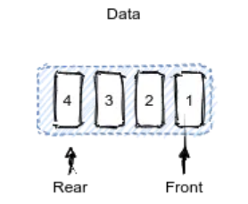
Bagian QUEUE
Front : antrian paling depan
Rear/Tail : antrian paling belakang

Slide 8
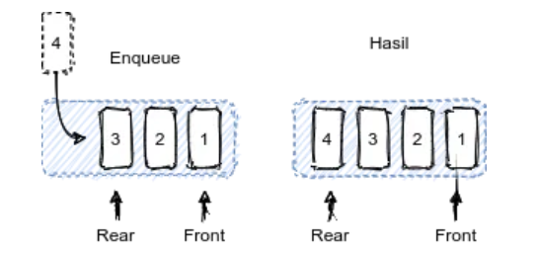
Enqueue
Enqueue : proses menambah item/data ke dalam queue

Slide 9
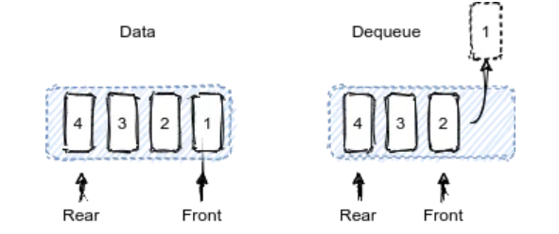
Dequeue
Dequeue : proses menghapus item/data ke dari queue

Slide 10
Operasi-operasi dalam Queue
enqueue() − add (store) an item to the queue.
dequeue() − remove (access) an item from the queue.
peek()/front()/head() − Gets the element at the front of the queue without removing it.
rear()/tail() - Get the last item from queue.
isfull() − Checks if the queue is full.
isempty() − Checks if the queue is empty.

Slide 11
Steps for ENQUEUE
Check the queue is full or not
If full, print overflow and exit
If queue is not full, increment tail and add the element

Slide 12
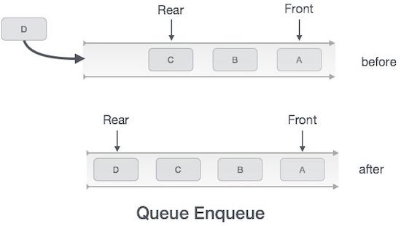

Slide 13
Steps for DEQUEUE
Check queue is empty or not
if empty, print underflow and exit
if not empty, print element at the head and increment head

Slide 14
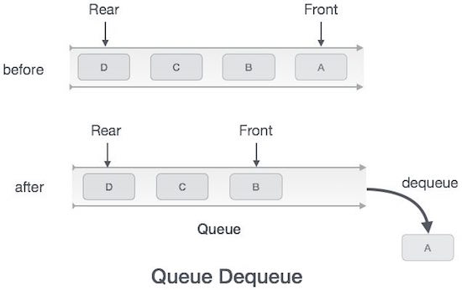

Slide 15
Array implementation Of Queue
For implementing queue, we need to keep track of two indices, front and rear. We enqueue an item at the rear and dequeue an item from the front. If we simply increment front and rear indices, then there may be problems, the front may reach the end of the array. The solution to this problem is to increase front and rear in circular manner.

Slide 16

QUEUE Implementation in Circular Manner

Slide 17
Implementasi
Implementasi QUEUE dengan Array

Slide 18
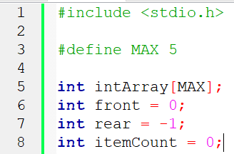
Deklarasi

Slide 19
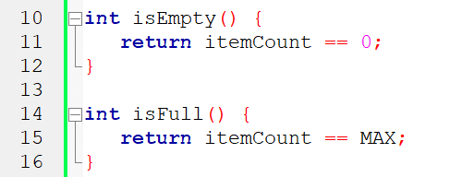
Operasi isFull dan isEmpty

Slide 20
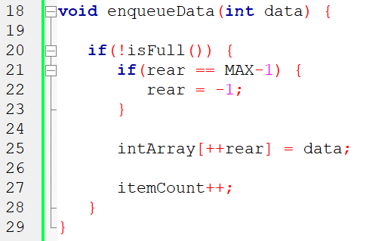
Operasi Enqueue

Slide 21
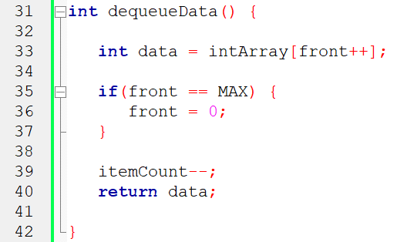
Operasi Dequeue

Slide 22
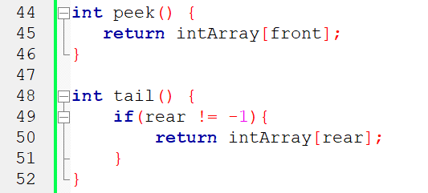
Operasi head() & tail()

Slide 23
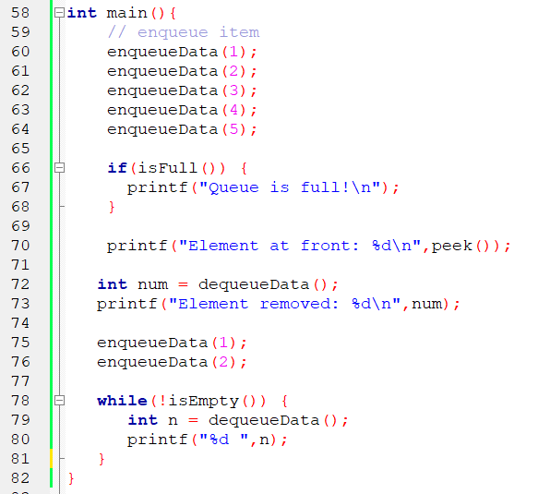
Contoh program main()

Slide 24
